Slide 1


Blood Donation Application
.
Bapuji Educational Association (Regd)
Bapuji Institute of Engineering and Technology, Davangere – 04
Department of Computer Science & Engineering
Guided By:
Dr. Nirmala C R
HOD
CS&E Department
Submitted By:
Maruthi . K.M
Megha R Jain
Keerthi.P

Slide 2
Contents:
Introduction.
Problem Definition of existing system.
Scope & Objectives.
Proposed system & its Benefits.
Functional & Nonfunctional Requirements.
Screenshots
Conclusion

Slide 3
Introduction:
Online Blood Donation management system is to create an e-information about the donor and organization that are related to donating the blood
Through this application , interested person can register himself with the system & organizations can also register with the site.
Moreover if any general consumer wants blood can request online & can also take the help of this site.

Slide 4
Problem Definition of existing system:
Entering the details about the Blood groups, members, address etc. And tracking the data base is complicated when the details are maintained manually .
Limitations of Manual system:
It is time consuming.
It leads to error prone results.
It consumes lot of men power to better result.
It lacks of security .
Retrieval of data takes lots of time.
Reports takes time to reduce

Slide 5
Scope & Objectives:
The main objective of this project is to support the people in automated tracking of blood by giving city or Blood group.
To maintain the donor details.
To help the needy in Emergency via our Web Application.
Technologies :
Php, Html, Css, Javascript.
Services :
Cleardb(database) , Monitoring & Analytics.

Slide 6
Proposed System & its Benefits.
The system is used for maintaining availability of Blood & the registered users.
There are two modules in this Project:
Donors : Is the one who Donates the Blood.
Acceptors: Is the one who Receives the Blood.
It overcomes emergency issues of Blood.
It Consumes less Man Power to give better result.
Retrieval Data at Faster Rate.

Slide 7
Functional Requirements:
Blood Donor Registration
Change the Login Password of donor
Update the Personal, Contact details by donor himself.
Blood Bank Registration.
Blood Bank can Add Available Blood Groups .
Admin can delete the information if
Non Functional Requirements:
In addition to describing the Functional requirements of the system, it will also provide non functional requirements. In practice this would include analysis of issues such as Availability ,Security & Maintainability of blood.

Slide 8
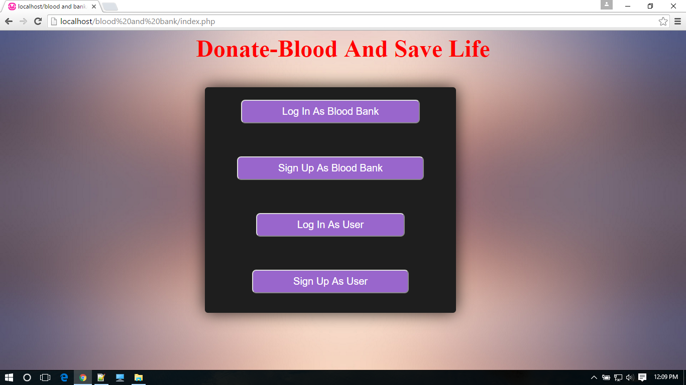
Screenshot of Index page

Slide 9
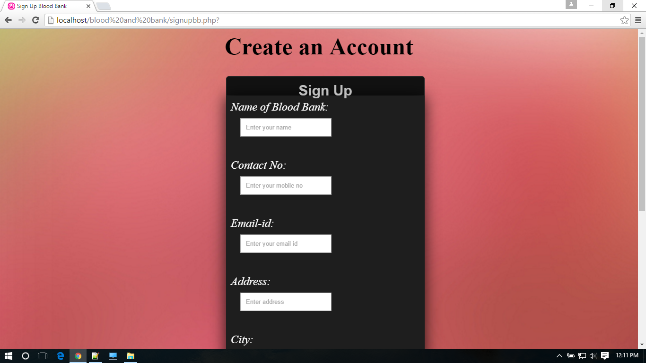
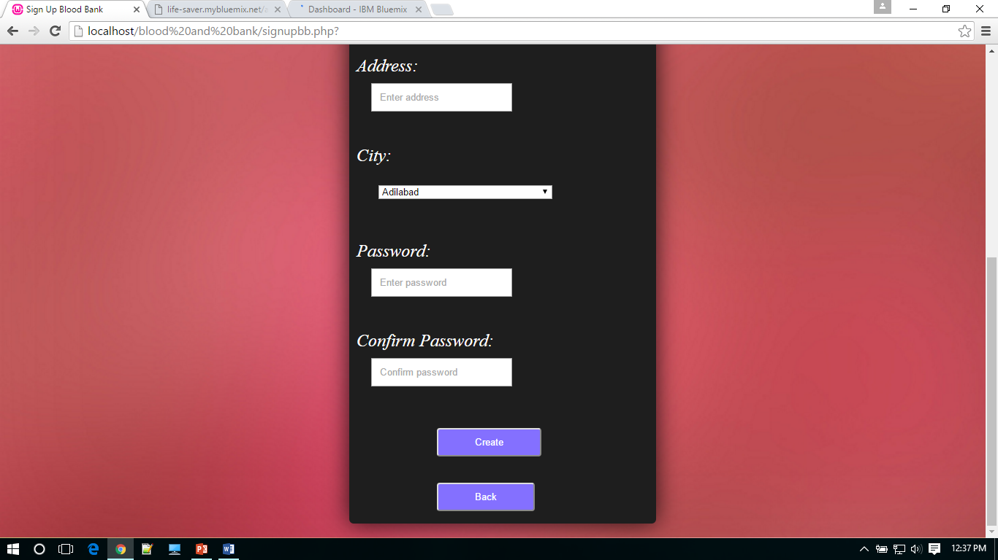
Screenshots of Blood Bank

Slide 10
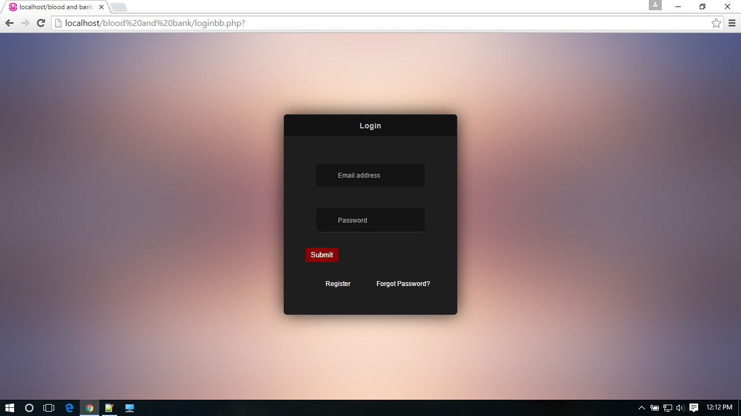
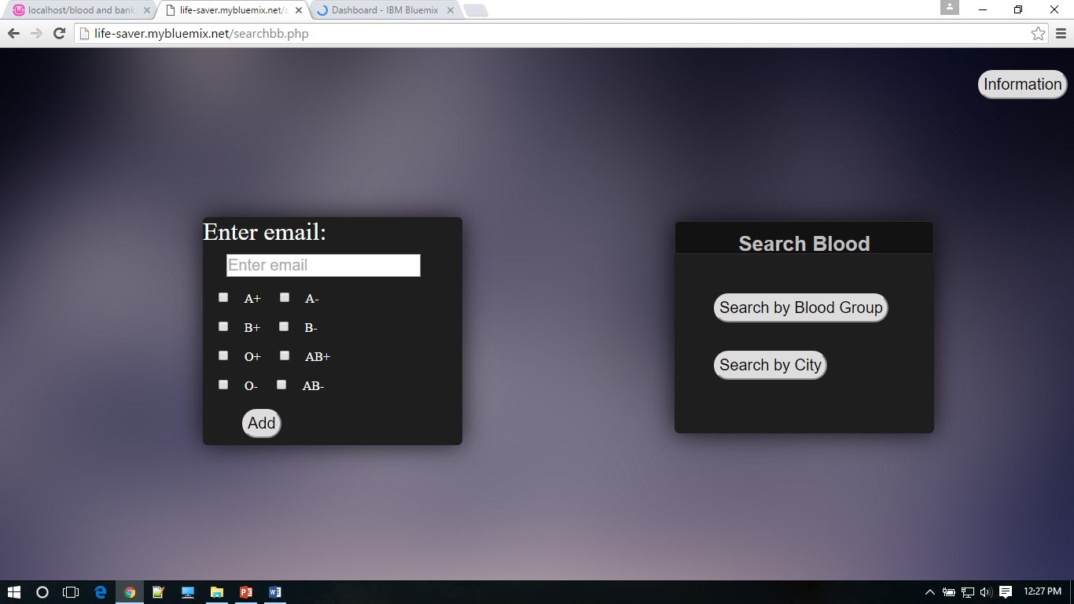

Slide 11
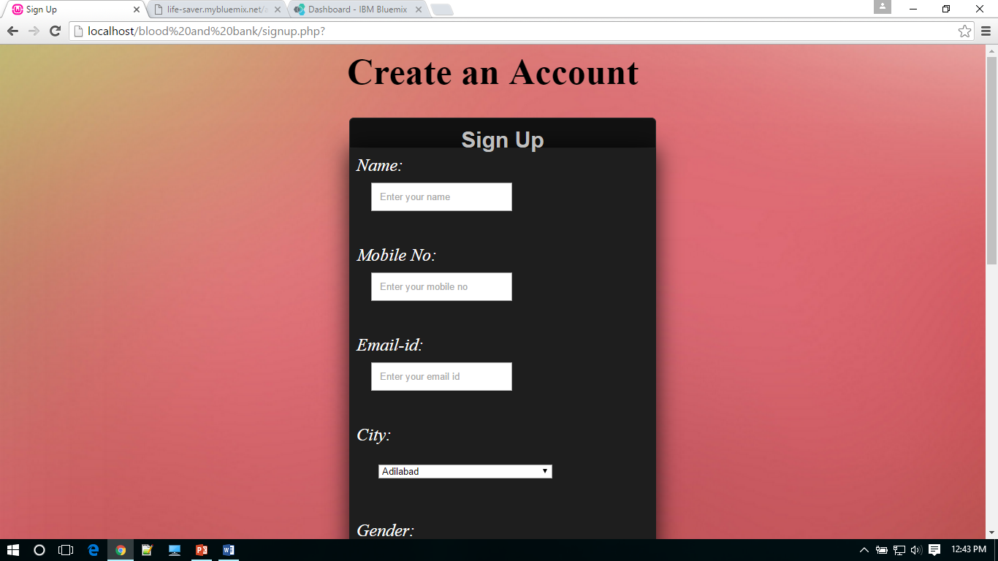
Screenshots of Individual User

Slide 12
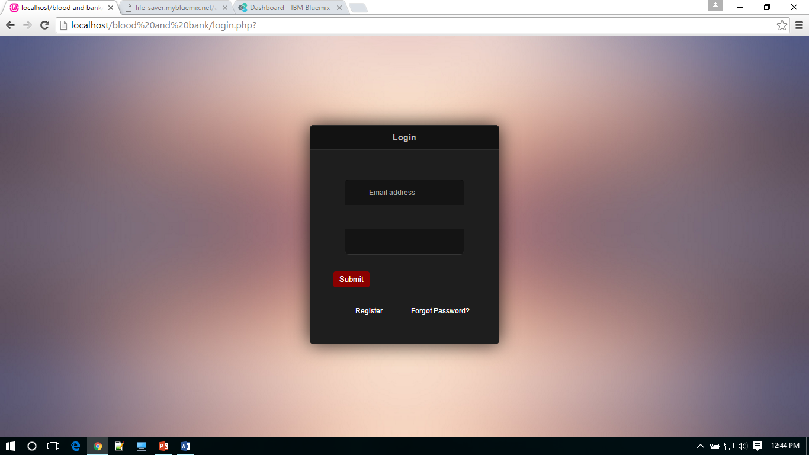
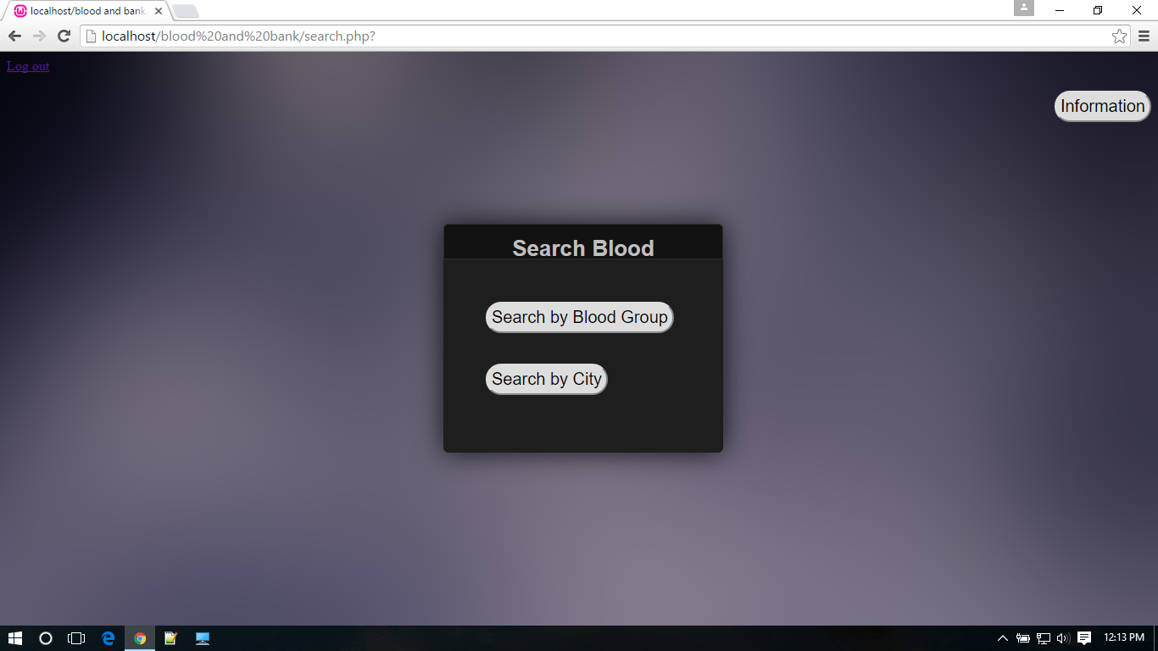

Slide 13
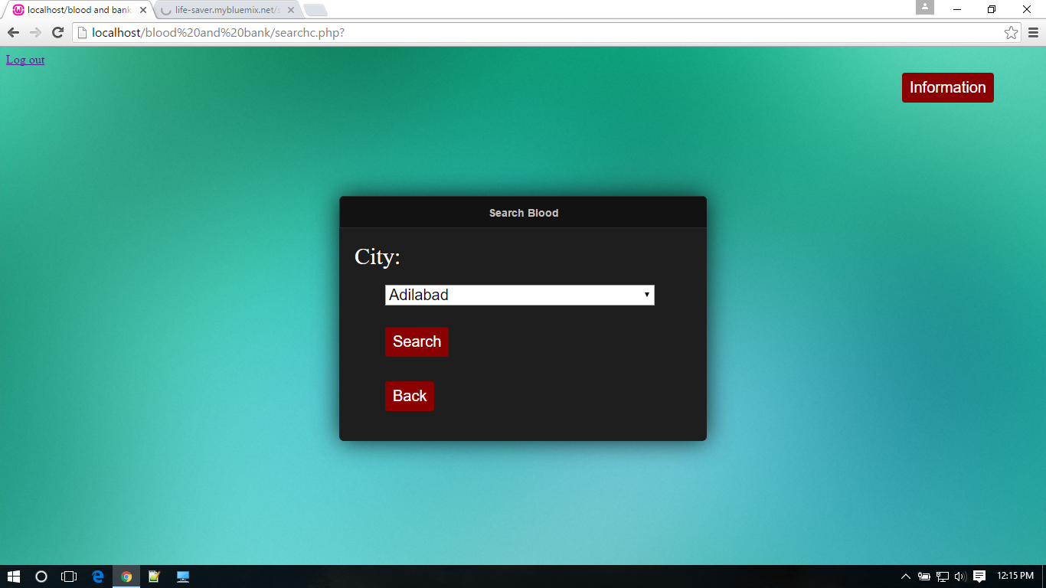
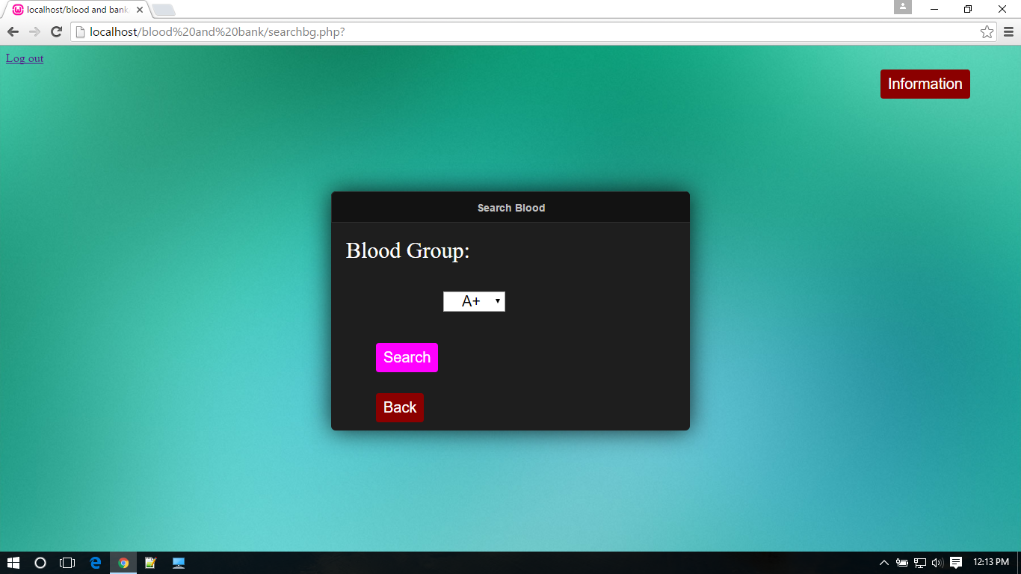

Slide 14
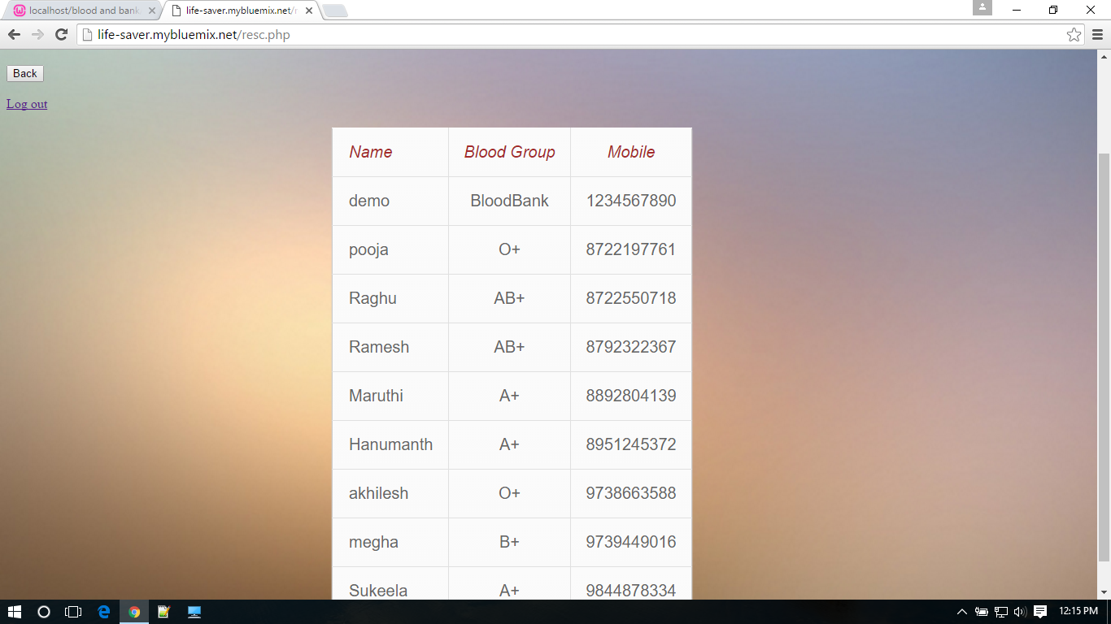
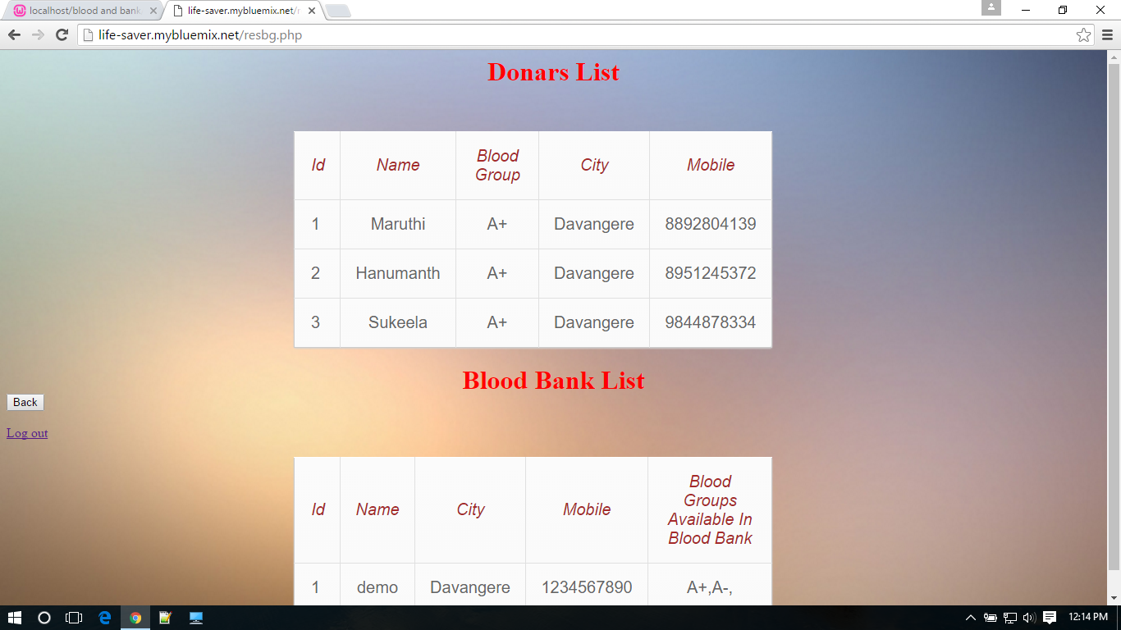

Slide 15
Conclusion:
We can conclude by saying that Blood Donor Web Application that helps Blood Bank and Acceptors who look for Donors in their nearby area and required Blood in quick time.
Helps to access the nearby Blood Banks to the common User.

